Slide 1
Depth Inverting Autoencoders for Images under Occlusion
AISWARYA SUBRAMANIAN

Slide 2
What is it all about?
> Hypothesis : Recurrent processing in networks help in image recognition under partial occlusion.

Slide 3
Motivation
> Human brain has recurrent dynamics which aids in visual perception.
> “Inference task” is inferring the latent causes that best explain the image and “Graphics task” is generating the image from this latent representation.

Slide 4
> Graphics may be used at each stage to check whether its inferences are consistent with the input that is, whether the higher level representation accurately explains the lower level representations.

Slide 5
Task
> The objects used throughout the thesis are digits. Each image has two digits occluding each other.
> The task is to reconstruct this input image with the depth order of the digits reversed.
> Occlusions introduce drastic loss of information and hence this task helps us understand, how recurrence might help networks to do inference on images with occlusions and to infer depth from them.

Slide 6

Data
Input Target

Slide 7
Research Question
Question : How does recurrent processing help an autoencoder in image reconstruction, when the objects are under occlusion in the image?

Slide 8
Architecture Overview
> The autoencoder has three convolutional layers and three fully connected layers in encoder as well as decoder.
> Feedforward connections (B), Feedback connections (T) and lateral connections (L) may or may not be present varying the level of recurrence in the network.

Slide 9
24 units
256x24
24x256
256x256
256x256
32x8x8
32x4x4
512x256
256x512
32x4x4
32x8x8
32x16x16
32x16x16

Slide 10
Learning
> The number of time steps is set to 4 and the size of code layer is 24 throughout the thesis.
> The mean squared error is calculated between the readout values that encoded input image and the target.
> To train the network, the mean squared error is back- propagated through time.

Slide 11
> The loss is calculated after four time steps are run, and the loss at the final step is considered as the total loss.
> Stochastic gradient descent was used with a batch size of 100 images, parameter-wise learning rates scaled by the ADAM method with default parameters beta1 = 0.9 and beta2 = 0.999.
>A weight decay rule was also set up, such that every 40 epochs the learning rate decreases by a factor of 10.

Slide 12
Comparison of models with different levels of recurrent processing
> We can have different autoencoder architectures, depending on the level of recurrent processing (B, BL, BT, BLT) present in the encoder and the decoder.
> So, by using different combinations of encoders and decoders, we have a total of 16 models.
> I have plotted the lowest train-generalization losses for all the 16 models.

Slide 13
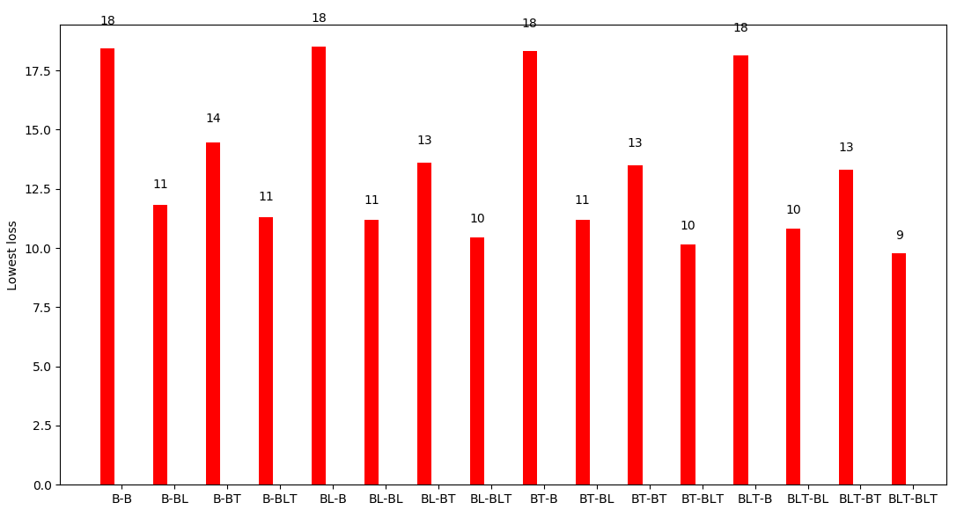
Train Loss vs Model
Model

Slide 14
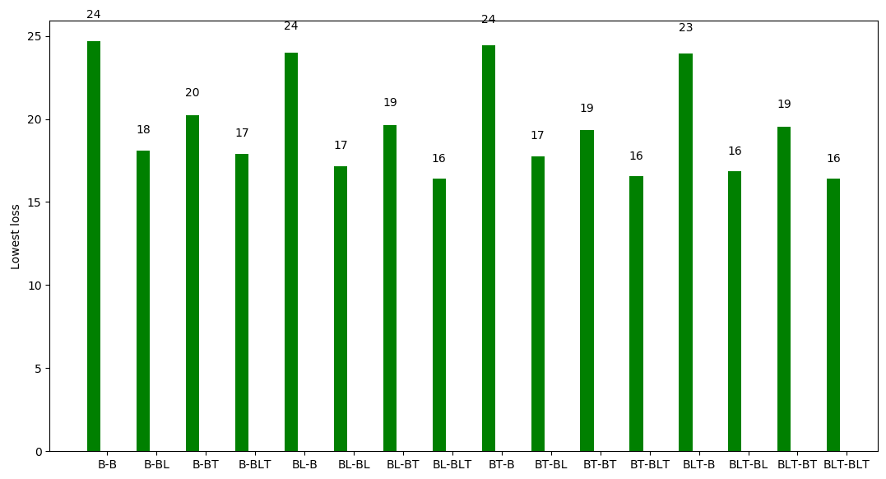
Generalisation Loss vs Model
Model

Slide 15
> Recurrent connections in encoder plays significantly lesser role than in decoders.
> Performance of B-B, BL-B, BT-B and BLT-B are almost the same whereas, B-BL significantly improves the model.
> Lateral connections are significantly more important than top down connections in decoder.

Slide 16
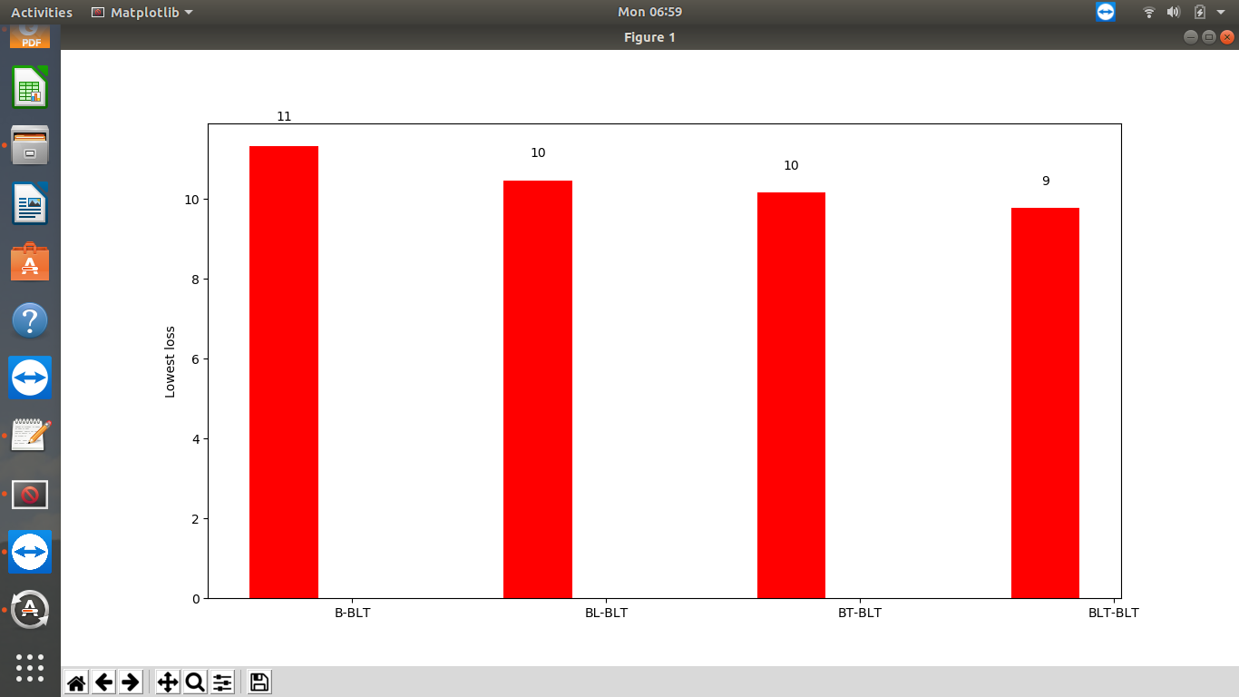
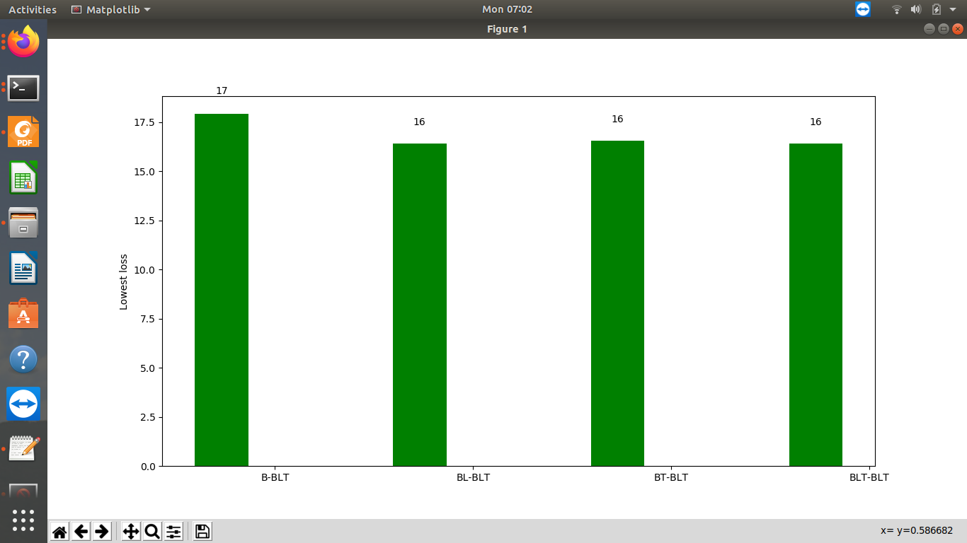
Encoder Comparison

Slide 17
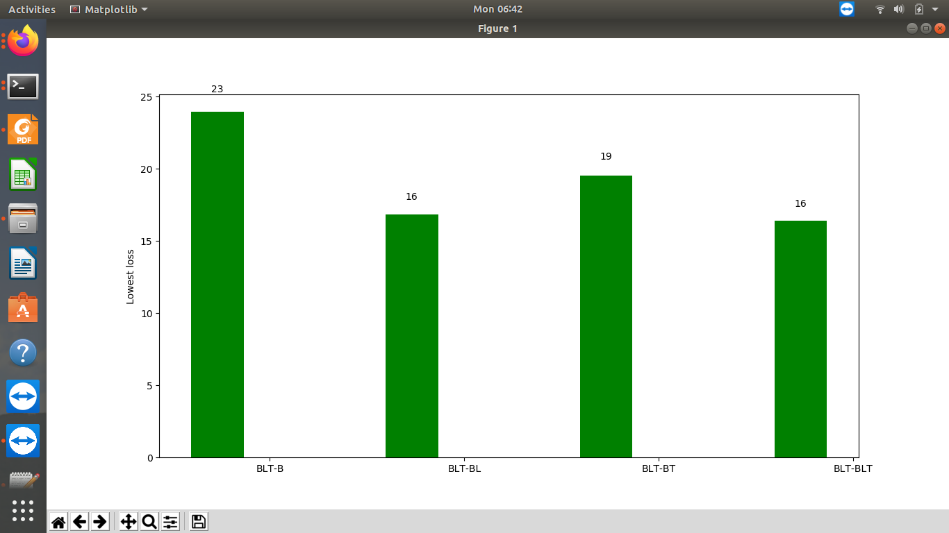
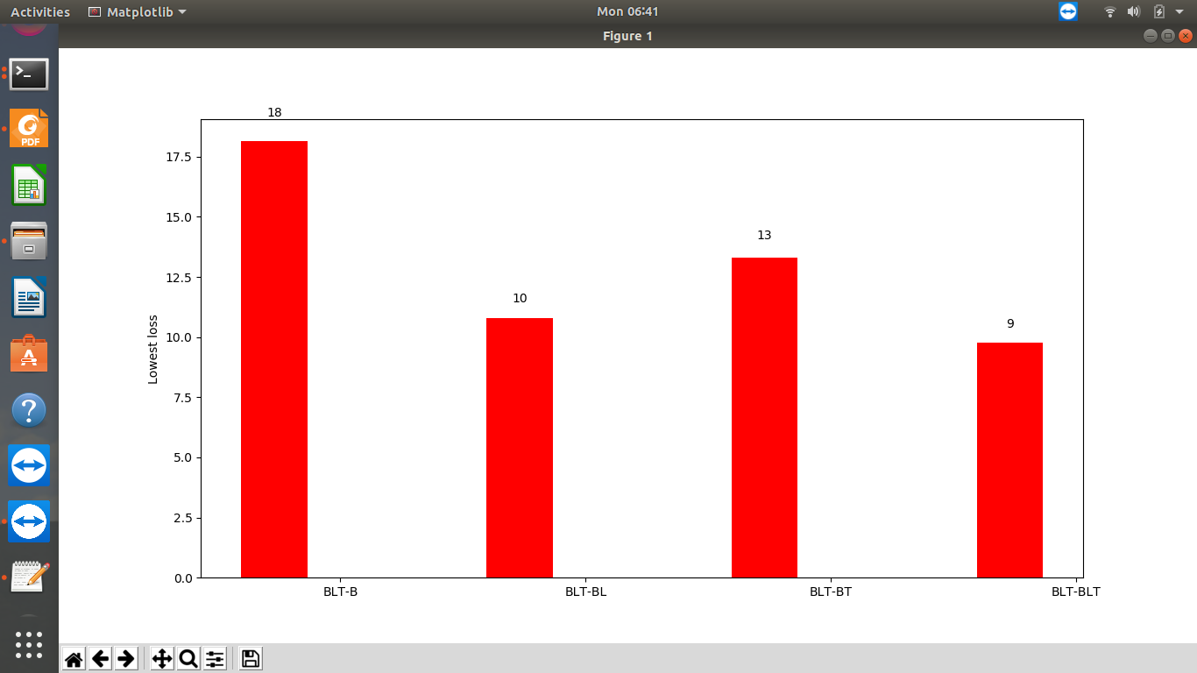
Decoder Comparison

Slide 18
Are the digits indeed identified & inverted in order?
> One possible way is that the network is breaks the digit into different pieces and encodes which all parts are to be present in the reconstructed output.
> In any case, if digits are not identified as whole, then if the input is partially hidden, that will be reflected in reconstruction output.

Slide 19
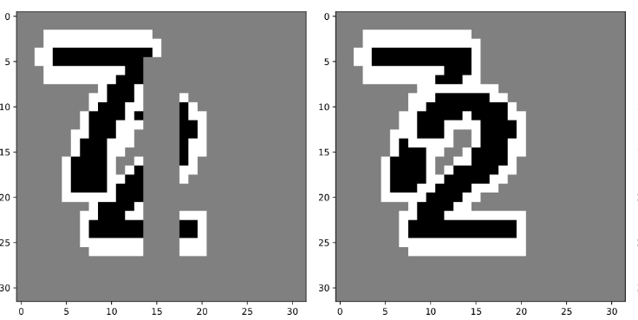
> So I created a new test data set as shown.
> Each test point has a grey bar (same color as that of background) placed at random positions.
> If the model isn’t identifying the digits & inverting them in order, then it should reproduce the bar in the reconstructed output.
> Next slide shows the results.

Slide 20
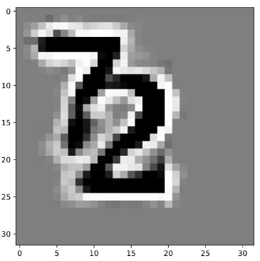
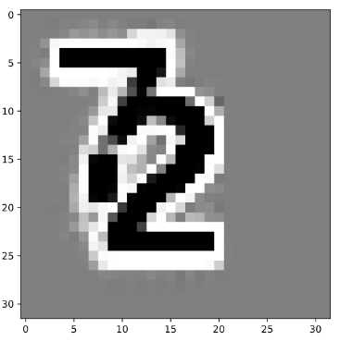
B-B autoencoder output
BLT-BLT autoencoder output
Input Target

Slide 21
How well does the model work when occlusion is not present?
> We have seen that both B-B and BLT-BLT autoencoders work when digits occlude each other.
> Now the question is whether the benefit we saw for recurrence with occlusive digits actually had anything to do with the occlusions.
> It is so possible that they just reflected a general sharpening of the generated images.

Slide 22
> If that is the case, a similar pattern should also translate to non-occlusive digits also
> In order to test this, I have created a new dataset as shown in next slide.
> I have created this data by blending both the digits with a blend factor of 0.5. I have run all the 16 models on this non-occlusive data, to see if a similar pattern to occlusive data is present here also.

Slide 23
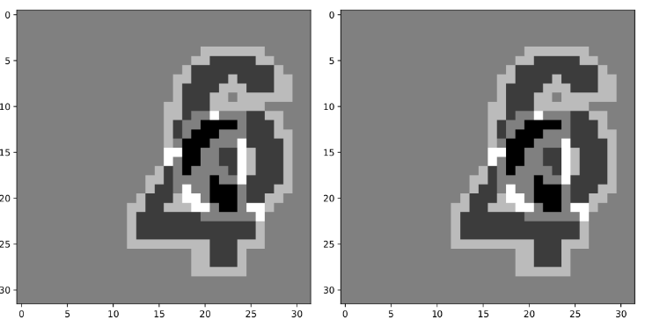
Input Target

Slide 24
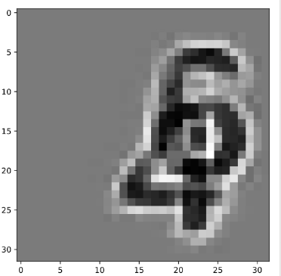
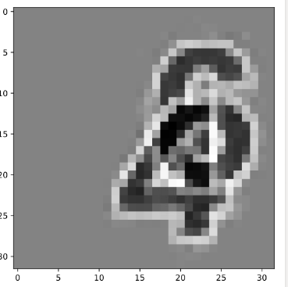
Blended Images
B-B autoencoder output
BLT-BLT autoencoder output
Input Target

Slide 25
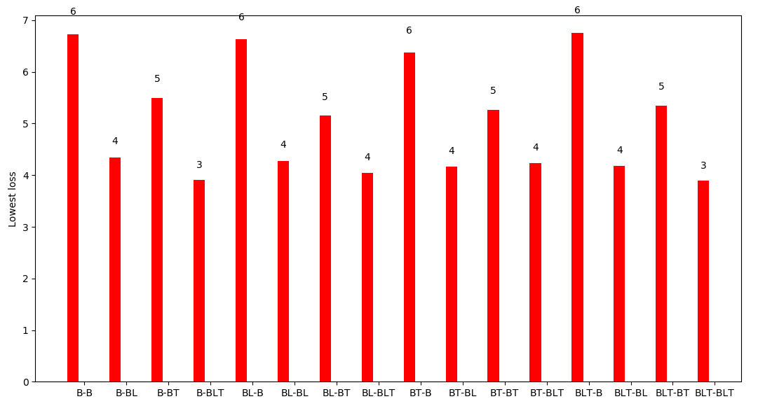
Comparison of models with different levels of recurrent processing : non-occlusive data
Train Loss vs Model
Model

Slide 26
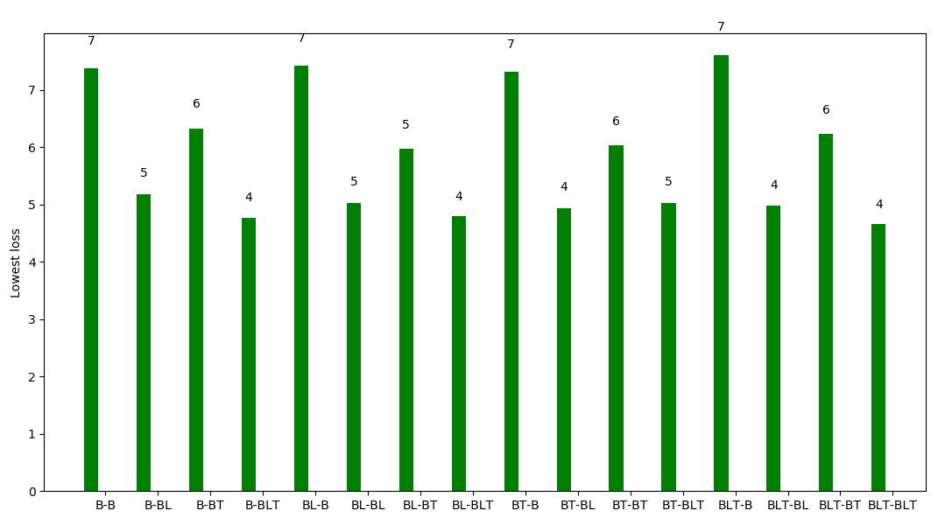
Generalization Loss vs Model
Model

Slide 27
> It can be observed that the model is showing a similar pattern in this case also.
> So, the following can be concluded:
Recurrent connections are significant in the decoder.
Lateral connections in the decoder play the major role in improving the accuracy of the model.
The model identifies the digits and invert their order.
The model can reconstruct the input image even if the occlusions are not present.

Slide 28
Higher levels of Occlusion
> In order to push the model further, I increased the level of occlusion in the image by adding one more digit into the image.
> This will help us understand whether the model can generalize to higher degrees of occlusions as well.

Slide 29
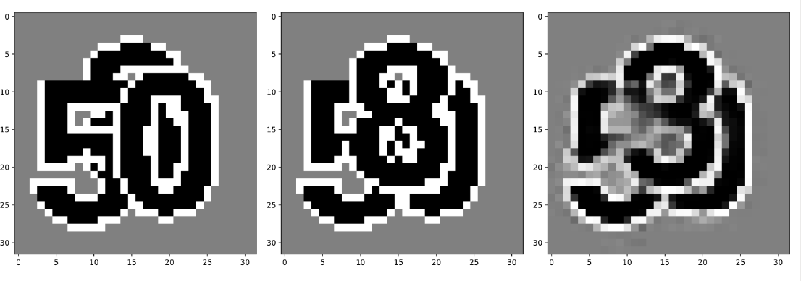
Input Target Output

Slide 30
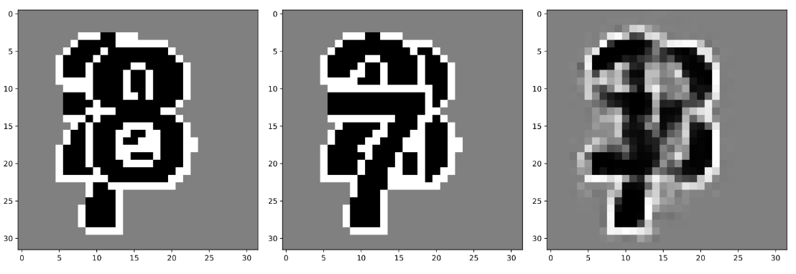
Input Target Output

Slide 31
> It can be seen that the model is not doing as well as in the two digit occlusion case.
> This can be because the model capacity is not enough to do the task. The model capacity can be increased by either increasing the number of code layer units or by increasing the number of time steps or both.

Slide 32
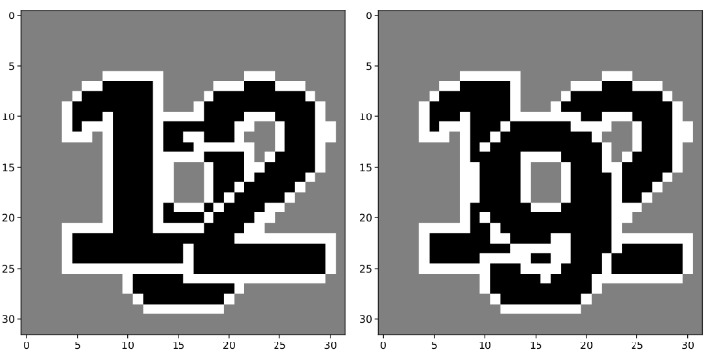
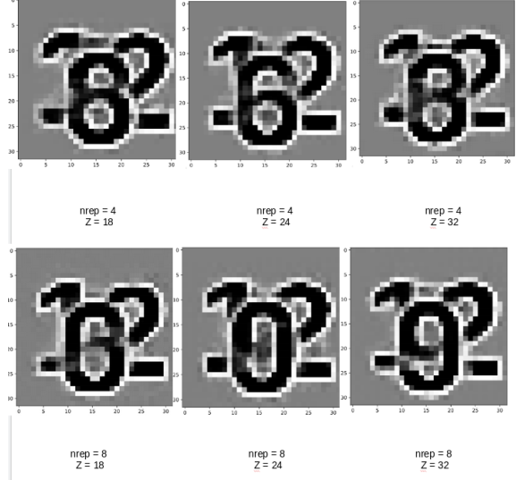

Slide 33
Can a shallow network do the task?
> Since recurrent connections don't seem to be important for occlusions as such in the deeper network, we want to see whether this is because those deeper networks have so much computational capacity that adding recurrence doesn't do much.
> So, I have started with a shallow network as shown in next slide.

Slide 34
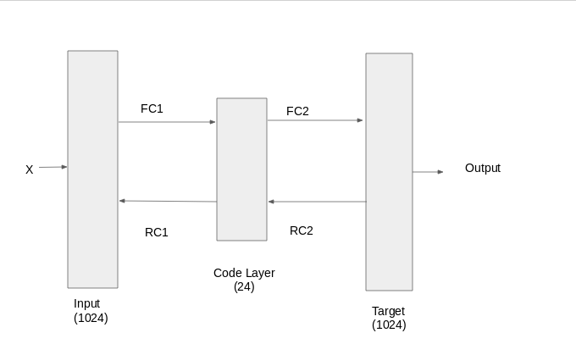

Slide 35
> This shallow autoencoder has feedforward (B) and feedback (T) connections in both the encoder and the decoder.
> I have not used any non-linearities in the model.
> This model is trained and tested on the border2 data where the digits occur at fixed positions and results are as shown.

Slide 36
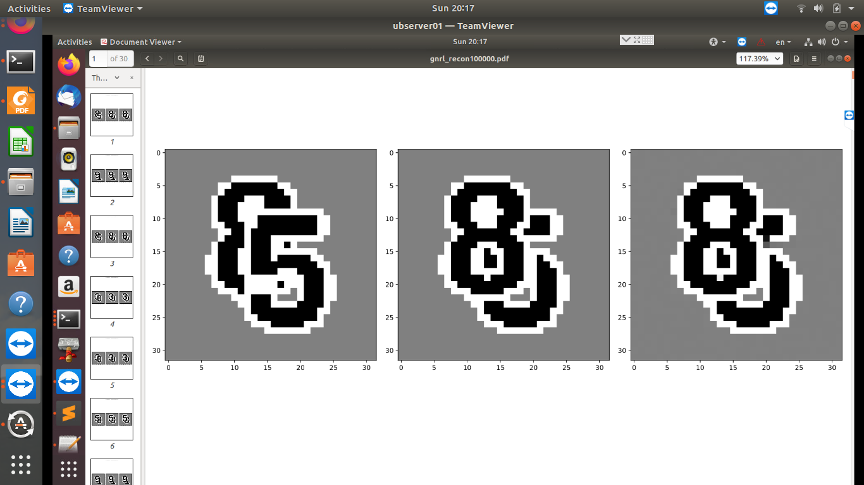
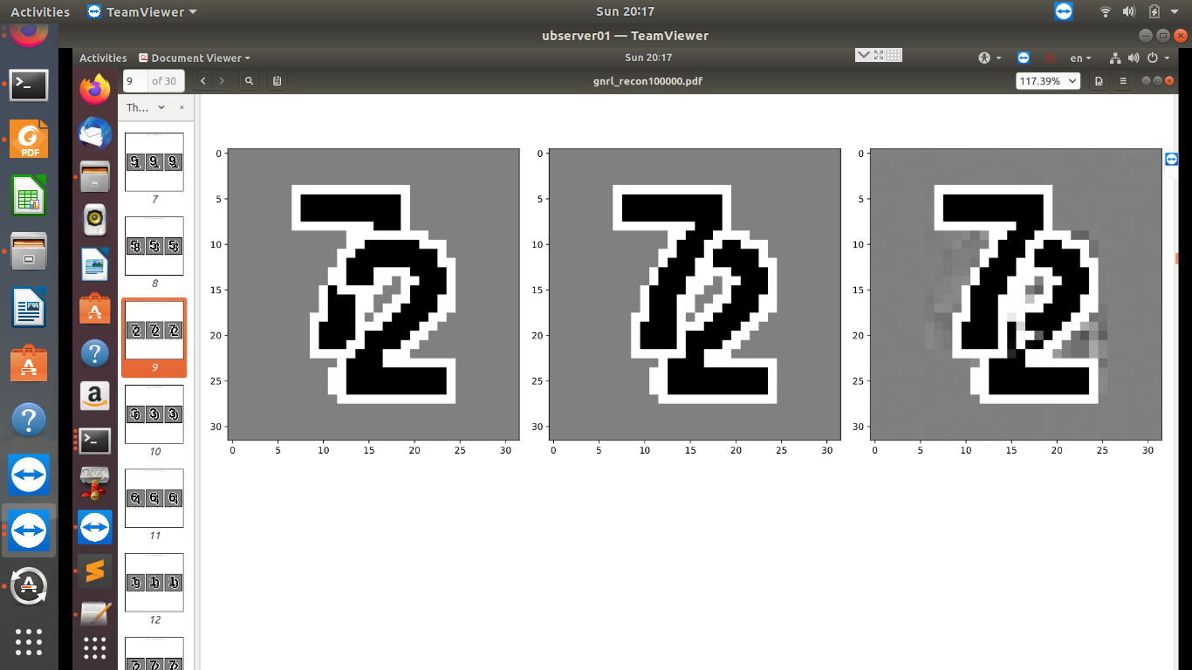

Slide 37
> We can see that the model is surprisingly performing well which is pretty counter intuitive.
> One possible reason could be that the data set is too simple.
> In order to see if the shallow model is identifying the digits and inverting them, I ran the model on the border2 data and tested on data with the grey bar as before.
> I have shown the results in the next slide.

Slide 38
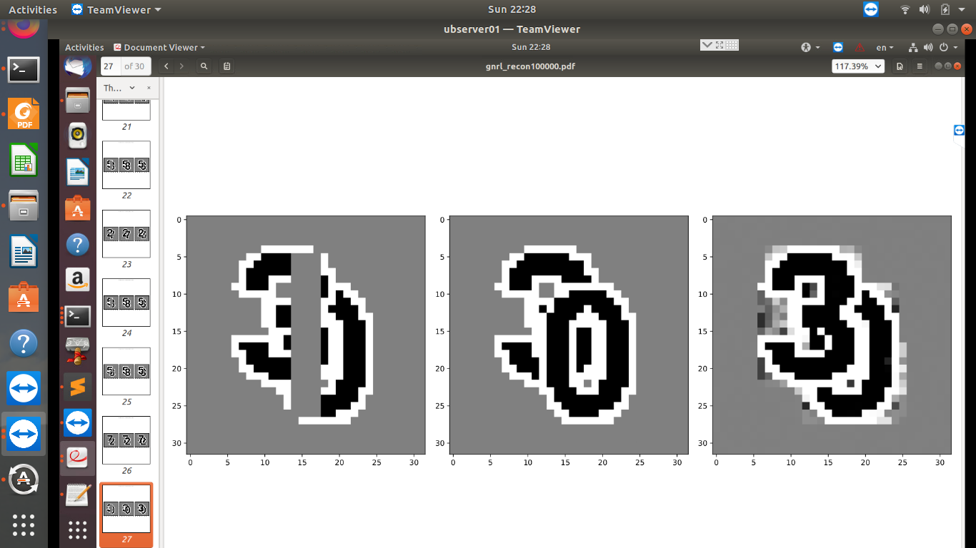
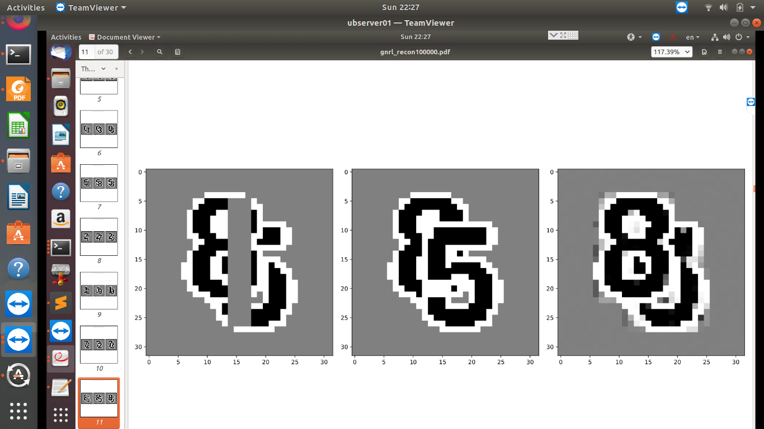

Slide 39
Summary
> The BLT-BLT autoencoder is able to give the best performance out of all autoencoder models.
> It has been shown that the model is able to identify the digits and invert their order. It has also been seen that lateral connections in the decoder plays the most significant role.
> But the shallow networks with just two fully connected layers raise a new question which has to be looked into.

Slide 40
Future Work
> In order to understand the counter intuitive results we just saw, we need to look into the code layer generated by the deeper and the shallow networks.
> One way to do that shall be to manipulate the code layer & see how the image changes. For an input image, the code layer size is 24. We can change one or two values in this 24 valued vector and reconstruct the image from the manipulated code layer.

Slide 41
> Another way shall be to manipulate the image and see how the representation changes.
> We should compare the code layer from both the deep and shallow networks to understand more about the results that we have got till now.

Slide 42


